Slide 1
BPSO: Binary Particle Swarm Optimization
M drugs * 593 Features
Make initial population (50 * 593) randomly Each row is one model
Create Initial Velocity
Create initial local best matrix which is equal to initial population
Create initial Global best row
Set α = 0.5 to start with (α controls the speed of the birds (models) lo0king for food 9getting close to the best model)
Step 1 (binary)
Initial Population
Created randomly
50 * 593
Initial Velocity
Created randomly
50 * 593
Initial Local best matrix
(same as initial population)
Global best row – that is the row with the best fitness
Step 2(Randomly between 0 and 1 - not binary)
Step 3 (binary)
Step 4 (binary)
Can be set to zero because we have not trained anything yet
Train the models
Update the local best Matrix
Update the global best row
During the implementation, the best model will be the model that has the lowest fitness. During the analysis the best model should be the combination of low fitness, and R² of training, Q² of training, R² of validation and R² of test are all greater than or equal to 0.5 and less than 1.
Update the velocity matrix
Update the value of α
α = α – [0.5-0.33)/10000]
Find new population

Slide 2
Main Program – Continue:
// Step 1:
Create Initial Velocity()
How to find the initial velocity:
for (i=0; i<50; i++)
for (j=0; j<593; j++)
{
Velocity[i, j] = random number between 0 and 1; // this is not binary. It is between 0 and 1
}
// Step 2: Create the initial population as you did before and train it
// Step 3:
UpdateLocalBest Matrix()
// The initial local best matrix is the same as the initial population to start with
// Step 4:
UpdateGlobalBestRow ( )
// The initial global best row is the row in the initial population with the best fitness
===============================================================================

Slide 3
Main Program – Continue:
// Step 5:
Find the new value of α (it should decrease from 0.5 to 0.33). Therefore, if you do K iterations, each time you need to subtract (0.5 - 0.33) / K.
Suppose p = (0.5) *(1+α) )
FindingNewPopulation(….)
- If (velocity[i][j] <= α) then population[i][j] = old-population[i][j]
- else if (velocity[i][j] > α and velocity[i][j] <=p ) then population [i][j] = local-best matrix[i][j]
- else if (velocity [i][j] > p and velocity[i][j] <=1) population[i][j] = global-best[j]
- else population[i][j] = old-population[i][j]
==========================================================================

Slide 4
Main Program – Continue:
// Step 5: Updating the new local best Matrix:
UpdateNewLocalBestMatrix(……)
// How to do that?
For each row “i” of the current population
If the fitness of the population[i] < fitness of local-best[i]
Local-best[i] = population[i]
Current Population
Local Best matrix
. . .
. . .
. . .
. . .
. . .
. . .
.
.
.
.
.
.
.
.
.
.
.
.
.
.
.
.
.
.
.
.
.
.
.
.
.
.
.
.
.
.
.
.
.
.
.
.
.
.
.
.
.
.
.
.
.
.
.
.
.
.
.
.
.
.
.
.
.
.
.
.
.
.
.
.
.
.
.
.
.
.
.
.
. . .
. . .
. . .
. . .

Slide 5
Main Program – Continue:
// Step 6: Updating the global row.
UpdateGlobalRow(……)
// How to do that?
The global row is the row of the local best matrix with the best fitness
Local Best matrix
. . .
. . .
Global Best Row
. . .
. . .
.
.
.
.
.
.
.
.
.
.
.
.
.
.
.
.
.
.
.
.
.
.
.
.
.
.
.
.
.
.
.
.
.
.
.
.
. . .
. . .

Slide 6
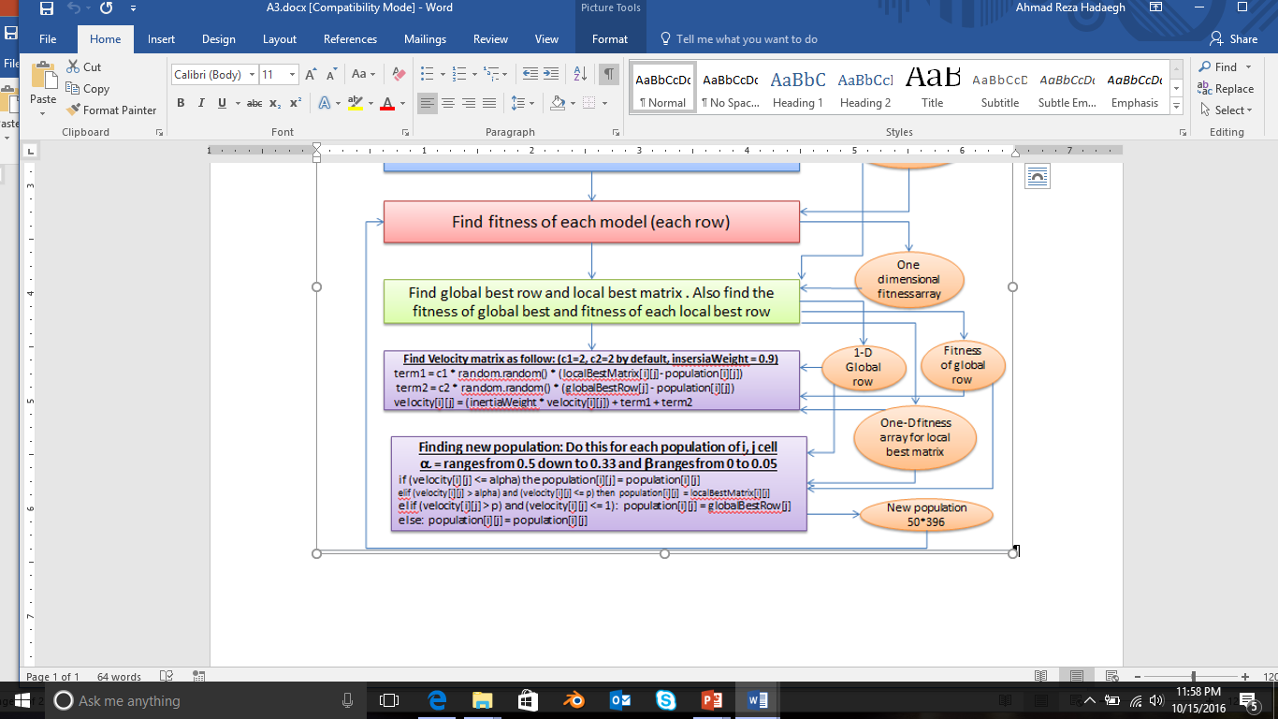
Main Program – Continue:
// Step 7: Update the velocity
UpdateVelocityMatrix(……)
// How to do that?
======================================================================
// Go back to step 3
c1 and c2 are acceleration constants and based on some experiments the best values for the is equal to 2.
To understand BPSP, you may read pages 5, 6, and 7 of the journal that is placed under project 4 of the cougar courses.

Slide 7
Best local matrix
1
1
Best Global row
50
50
Best local matrix
1
1
1
Best Global row
50
50
50
Population 1
Population 2
Population 3
1
1
1
Population n
Best local matrix
1
1
…….
Best Global row
50
50
50
50
50

